Slide 1
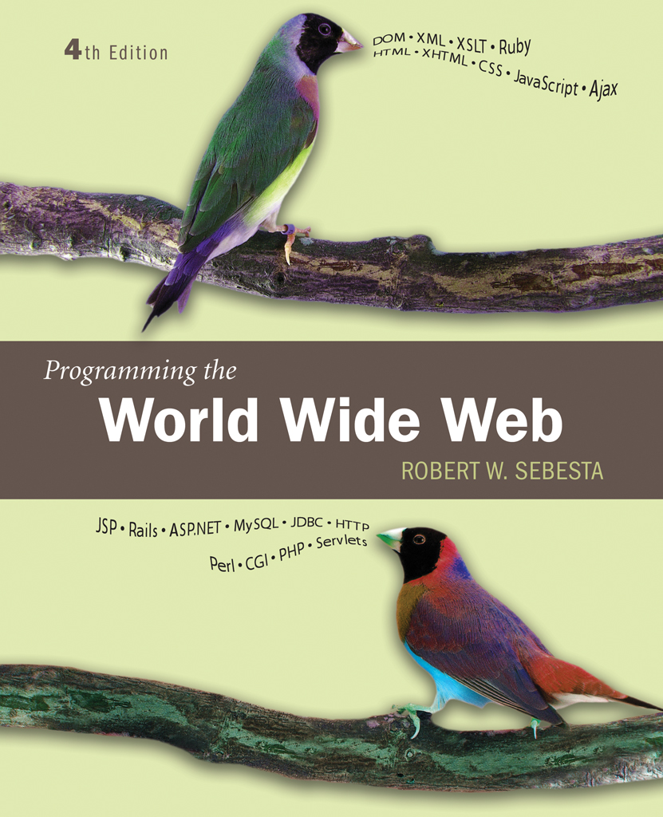
Chapter 15
Introduction to Rails

Slide 2
15.1 Overview of Rails
Rails is Ruby based
“A development framework for Web-based applications”
Rails uses the Model-View-Controller architecture
  Model classes are the data classes, including constraint enforcement
  View classes present the data to the user
  Controller classes perform computations and deal with user interaction
Rails uses an Object-Relational Mapping approach to working with databases
  A cars table corresponds to a car class
  The rows of the table correspond to instances of the class
  The correspondence is built automatically by the Rails framework
Rails uses a combination of Ruby code and template files to create responses

Slide 3
15.1 Developer Tasks
Design and build the model, including a database for storing model data
Design and implement actions
Design and implement the views

Slide 4
15.2 Document requests
The Rails framework provides much of the superstructure necessary for a web application
Scripts with the Rails framework set up the basic structure
The first Rails example serves a single static document

Slide 5
15.3 Project Setup
The InstantRails package provides all the components needed to develop and test Rails projects on a Microsoft Windows platform
Start the InstantRails console
InstantRails
Set up a rails application
rails rails1
Generate a controller
ruby script/generate controller say
Run the default server
ruby script/server
  The server runs for a particular application

Slide 6
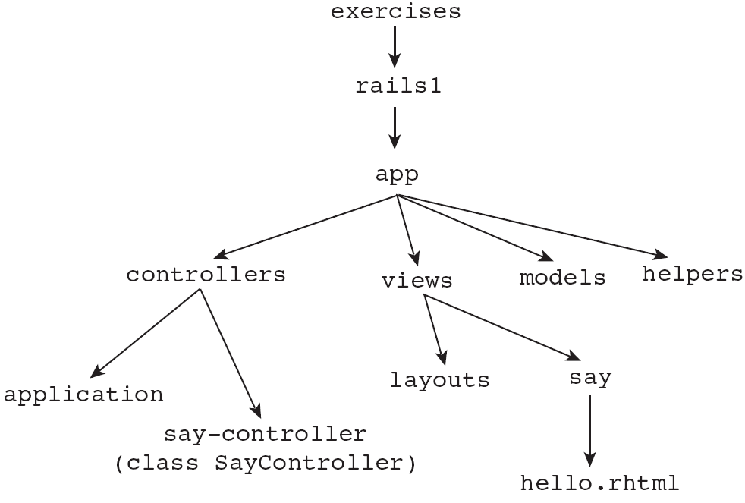
15.3 Project Directory Structure

Slide 7
15.2 Project Components
A controller class, SayController, in the controllers directory
The controller class has method named hello
An html template file (static for this example) named hello.rhtml in directory views\say
The Rails framework associates these components by the name ‘say’

Slide 8
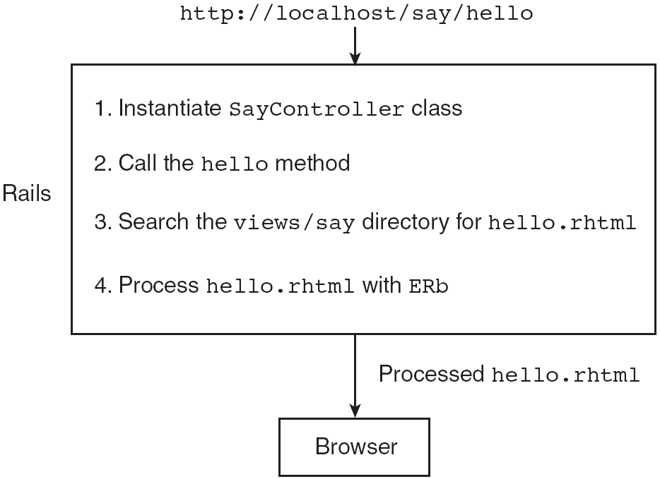
15.2 Request Processing

Slide 9
15.2 Dynamic Documents
The next example displays the greeting but also displays the current time
  Uses Time.now from the Ruby library
<% … %> embeds Ruby code in template files
  <%= … %> causes the value of the executed code to be inserted in place
Instance variables of the controller class can be accessed in the template file

Slide 10
15.3 Processing Forms
The popcorn example is used to illustrate accessing information from forms

Slide 11
15.3 Setting Up the Applications
A controller home is created
An empty action method the_form is created
A static template file the_form.rhtml is created to display the initial data entry form
The action on the form is simply “result” which links to an action method named result in the same controller class

Slide 12
15.3 The Controller and the View
Action method result in the controller class
  Get form data
  Compute results
Object params holds the form data in a hash-like object
  Can be indexed by symbols or by strings using widget names
  params[:phone] gets the phone number
  params[:unpop].to_i gets the unpopped amount as an integer
The sprintf method can be used to format data
  Used with format specification %5.2d to format floating numbers with exactly two decimal places

Slide 13
15.4 Rails Applications with Databases
This example uses the Corvettes database
The user specifies model year limits and body styles
The response is a list of matching cars

Slide 14
15.4 Building the Database
A database is created with four tables using MySQL commands
A script file is used to make the typing easier
Tables are named with plural names because of Rails names corresponding classes with the singular
Model classes are created
ruby script/generate model corvette
Directives in the model files specify the table relations
  has_many
  belongs_to

Slide 15
15.4 Building the Application
A table object gives access to the data in the table
  Method count gives the number of rows
  Method find is used to search
Method find
  One parameter is a primary key search. The matching row is returned
  Parameter :all requires a second parameter giving the value of the :conditions symbol, a test condition. All matching rows are returned
  Parameter :first requires a second parameter giving the value of the :conditions symbol, a test condition. The first matching row is returned
Method find_by_sql takes an SQL SELECT command
The action methods query the database and put results into instance variables
The matching template displays the results

Slide 16
15.5 Layouts
A layout template provides a standard template for other templates
  Put in the layouts directory
  Put a layout command in the ApplicationController class
The layout template can provide header and styling directions while other templates provide content
The @content_for_layout variable in the layout template provides the content from the other template

